Slide 1
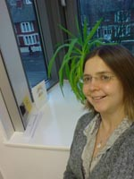
PROFESSORS VISITANTS 7-11 Novembre
Alison Bins Dra. en Optometria i Ciències de la Visió per la Cardiff University (RU)
Dilluns 7 Nov de 16:00 a 18:00. Aula 2.1.
Contrast sensitivity: physiology and clinical assessment
Dimarts 8 Nov de 8:00 a 10:00. Aula 2.2.
Visual acuity: physiology and clinical assessment.
Dimarts 8 Nov de 10:00 a 12:00. Aula 2.2.
Age-related macular degeneration: detection, referral and treatment.
Dijous 10 Nov de 12:00 a 14:00. Aula 2.2.
Advanced assessment of retinal structure and function (including electrophys. and OCT)
Aquestes conferències s’emmarquen en el programa english talks i estan obertes a tot l’estudiantat

